Slide 1



MINI PROJECT PRESENTATION
DESKTOP MOOD ROBOT
Submitted by
Fayaz Latheef
Abhiram CS

Slide 2
INTRODUCTION
This project is a gesture-controlled robot using an ESP32 with IR sensors, OLED display, and DC motors.
Based on Swipe detection, it shows happy or tired emotions, performs actions, and displays quotes from API, making the system interactive and engaging.
This is an initiative towards Behavioral robotics.

Slide 3
PROBLEM STATEMENT
Employees face high stress in office environments due to workload and deadlines.
Existing stress-relief methods are not always practical during work hours.
There is a need for a simple, desk-friendly, and autonomous solution.
A low-cost mood robot can provide touchless, calming interactions to reduce stress.

Slide 4
PROPOSED SOLUTION
A compact, Wi-Fi-enabled robot built on ESP32.
Uses two top-mounted IR sensors to detect hand gestures.
Fetches supportive messages from Perplexity AI API.
Displays replies on an OLED screen.
Operates autonomously without a PC after programming.

Slide 5
COMPONENTS USED
NAME | SPECIFICATION | UNIT
ESP 32 | DEVKITV1 | 1
OLED Display | SSD1306 | 1
IR Sensor | TCRT5000 | 2
DC Motor | Single shaft geared | 2
Motor Driver | L298N | 1
Battery | 3.7 Li-ion | 2
Jumper Wire

Slide 6
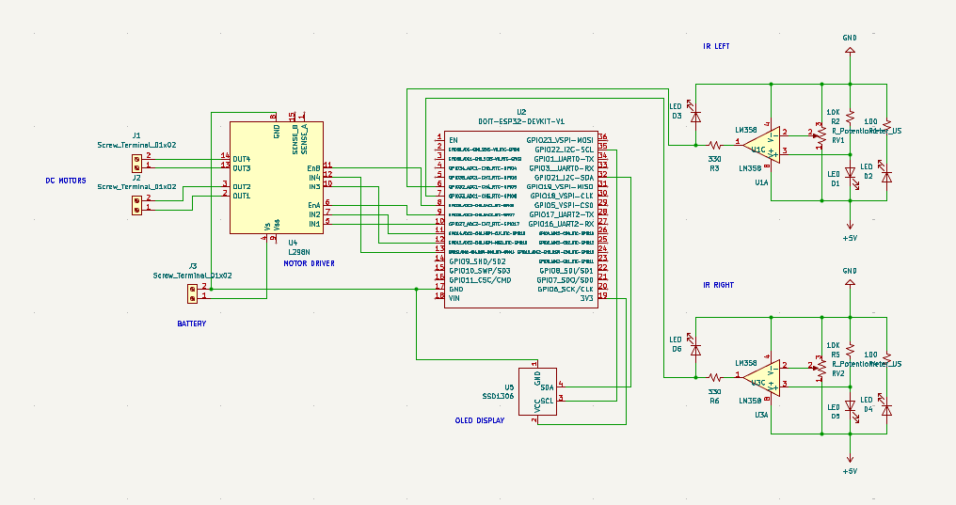
CIRCUIT DIAGRAM

Slide 7
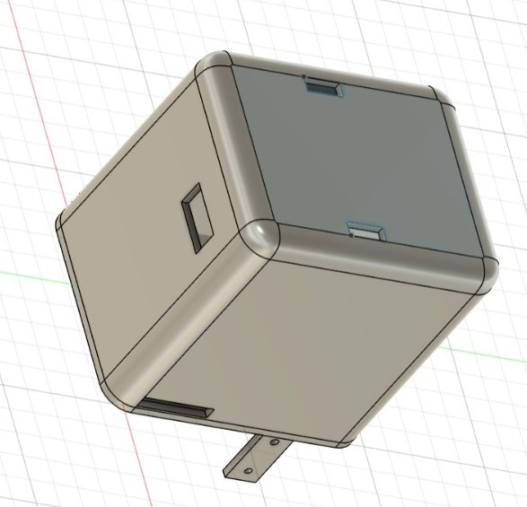
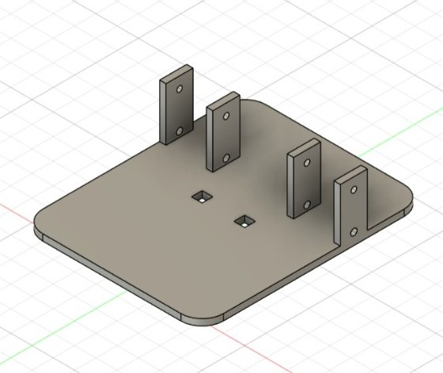
DESIGN
Upper body
Chassis

Slide 8
WORKING
Input & Detection
IR sensors detect hand gesture.
ESP32 interprets it as Happy or Tired.
Processing & Response
OLED displays corresponding expressions (idle, happy, Tired).
ESP32 requests quotes from API (send happy quote / send motivational quote).
Action & Output
On Happy: robot performs a 360° turn, displays happy face & quote.
On Tired: robot moves forward two times , shows tired face & motivational quote.

Slide 9
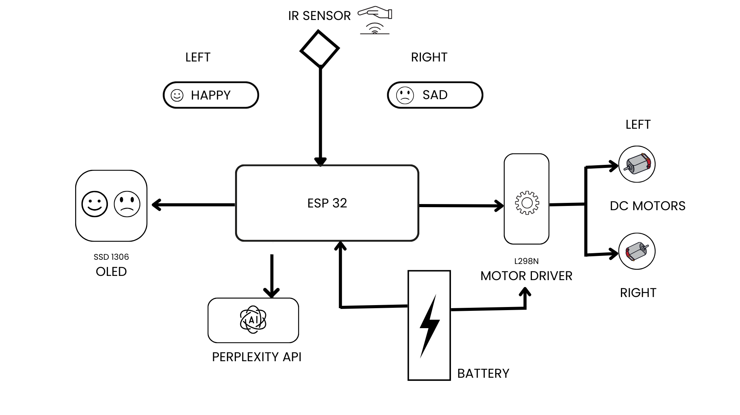
FLOWCHART

Slide 10
FUTURE SCOPE
Add Voice interface -mic and speaker for hands-free prompts and feedback.
Use on-device NLP
Add self-balancing with IMU and PID control.
Add SLAM & mapping using sensors (LiDAR + odometry)
Improve power and firmware reliability while optimizing chassis and motors for quiet, long-lasting operation.

Slide 11



THANK YOU

